Slide 1


Cracking Power BI Performance Tuning in a Day!
Nikola Ilic

Slide 2







Nikola Ilic
Consultant & Trainer
data-mozart.com
@DataMozart
I'm making music from the data!
Power BI and SQL Server addict, blogger, speaker...
Father of 2, Barca & Leo Messi fan...

Slide 3
Agenda*
09:00 – 09:10 | Intro
09:10 – 09:50 | Data Modeling
09:50 – 10:30 | Data Model Size
10:30 – 11:30 | Snack Break
11:30 – 12:30 | Data Refresh Process
12:30 – 13:30 | Lunch Break
13:30 – 13:50 | Aggregations
13:50 – 15:00 | DAX Calculations
15:00 – 15:30 | Snack Break
15:30 – 15:50 | Visuals Rendering Time
15:50 – 16:20 | Storage Mode Decision
16:20 – 17:00 | Final wrap-up, Q&A, Grande Quiz
*All times GMT

Slide 4



Data Modeling
@DataMozart

Slide 5

Why Data Modeling matters?
Import data “as-is”
Answer the business challenge
Reduce calculation complexity

Slide 6
Star schema in a nutshell
Dimension tables help us to analyze the things we measure​
The things we measure are stored in fact tables (most of the time).
There can be more than one fact table
“Star Schema - The complete reference​” - Christopher Adamson ​ ​ In a dimensional design, measurements are called facts, and context descriptors are called dimensions.​
Star schema importance for Power BI - MS Docs

Slide 7
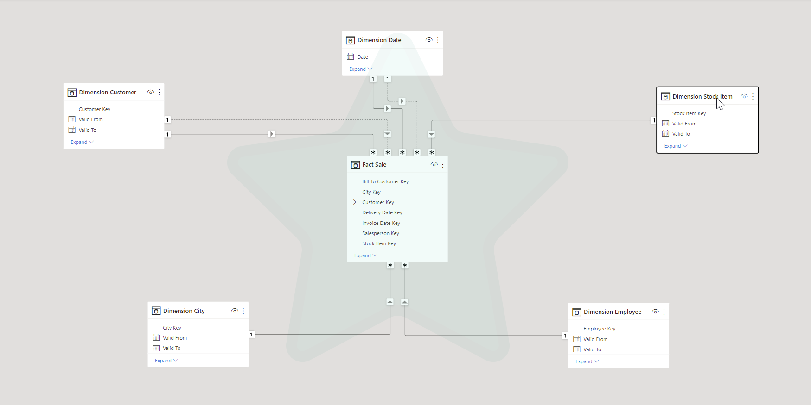

The Star Schema
When
To whom
What
Multiple date fields in fact table
Use each of them in calculations
How much
Where
Who

Slide 8
Star schema all the way ?
The cost of data modeling​
Separating dimension and fact tables from wide data source (SharePoint list​)
Combining different tables into a single dimension table or a single fact table​
Separating values with different granularity into different fact tables​
As always, it depends!

Slide 9
Why Star schema ?
DAX measure complexity
Simple requests become nightmare (without Star schema)!

Slide 10

DEMO
Calculate Year-To-Date value

Slide 11
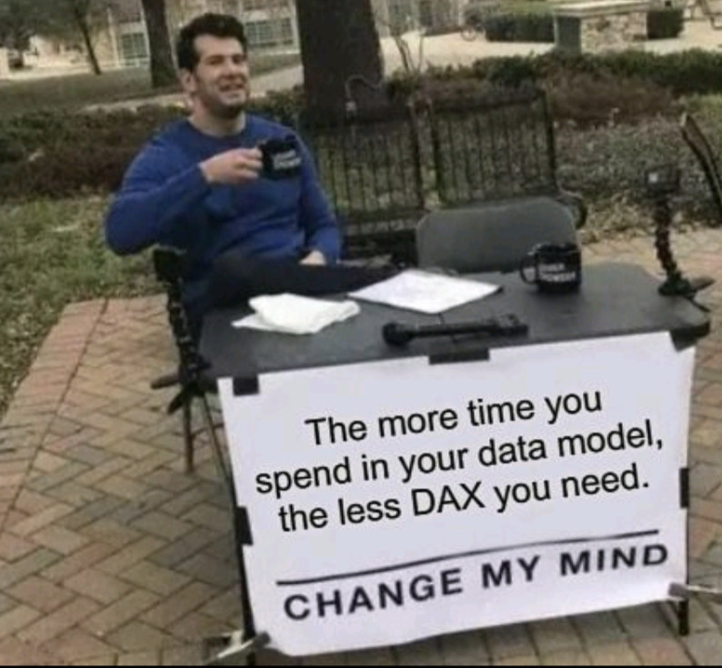
Why Star schema ?

Slide 12
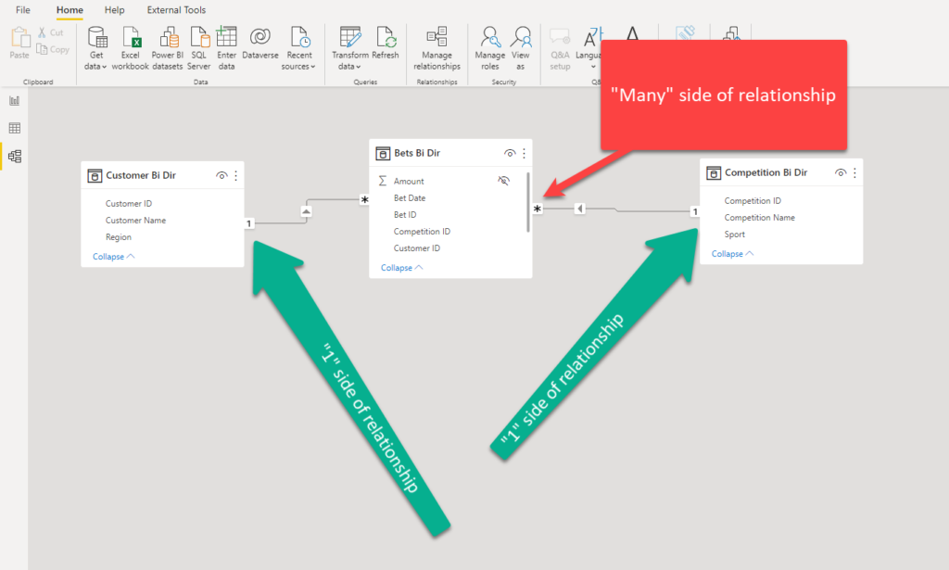
Bi-directional relationships
Why bi-directional relationships exist in so many models?
1:1, M:M scenarios​
Slicing “with data” items​
Dim to Dim analysis

Slide 13
Bi-directional relationships
How to avoid them?
Create a proper data model!
CROSSFILTER instead of Bi-dir

Slide 14
DEMO
Avoid Bi-dir relationhsips

Slide 15

Data Model Size
@DataMozart

Slide 16
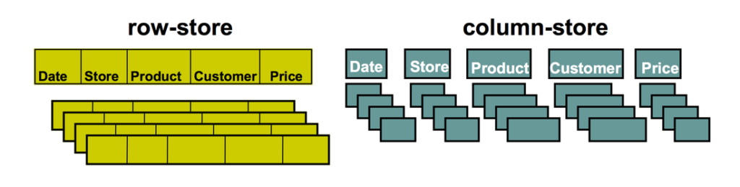
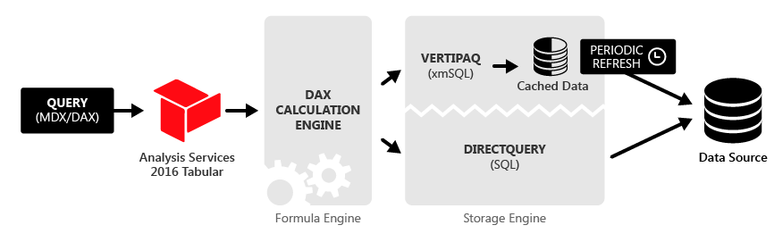
What is a VertiPaq?
Row-store vs columnar databases
Formula engine vs storage engine
Source: The Definitive Guide to DAX, 2nd Edition (M.Russo & A.Ferrari)

Slide 17

Formula Engine
„Brain“ of Power BI !!!
Understands DAX and translates it
Works in single thread !
1. Accepts the request
2. process the request
3. Generates query plan
4. Executes the query

Slide 18

Storage Engine
„Muscles“ of Power BI !!!
3 possible options to choose from *
Works in multi-thread !
*
1. Import mode
2. Direct Query
3. Dual

Slide 19

Import Mode
Based on VertiPaq
Data stored in-memory as a snapshot
Data is being refreshed periodically

Slide 20

Direct Query
Data is retrieved from the data source at the query time
Data stored in original source before, during & after the query execution

Slide 21

Import Mode in-depth
Reads data source
Encodes & compresses data
Establish dictionary
Build relationships
Calculated columns & tables

Slide 22
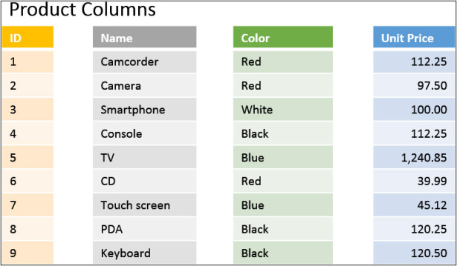
How VertiPaq stores the data?
VertiPaq is a columnar in-memory database
VertiPaq chooses optimal compression algorithms for each column!

Slide 23

Encoding Types
Value encoding
Hash encoding (Dictionary)
RLE (Run-Length-Encoding)

Slide 24

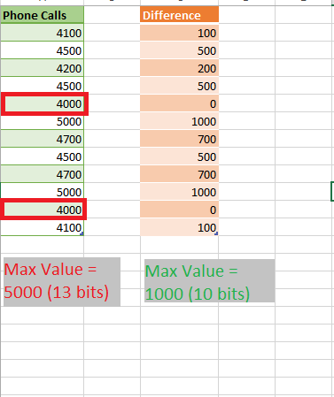
Value Encoding
The most desirable
Works exclusively with integers

Slide 25
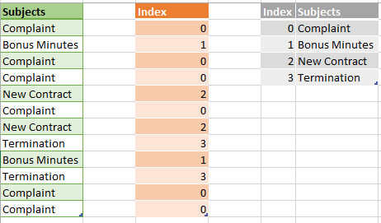
Hash Encoding
The most frequent
VertiPaq creates a dictionary!

Slide 26
Hash Encoding
VertiPaq is practically data type independent!
Data type affects column size – it‘s a myth!!!
Cardinality is the main factor

Slide 27
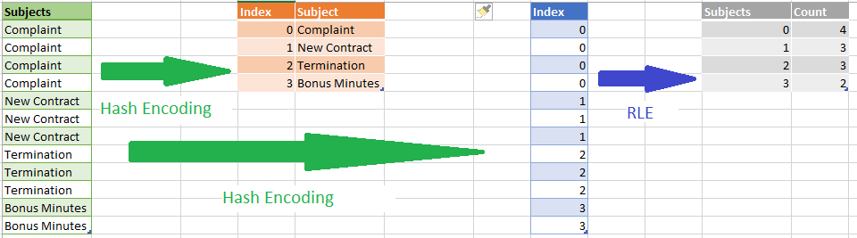
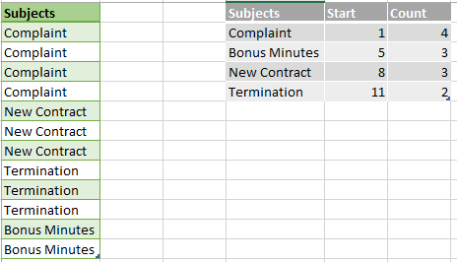
RLE (Run-Length-Encoding)
Mapping table with ranges
Highly dependent on the ordering within column
RLE always comes after Hash/Value encoding!

Slide 28

How VertiPaq “thinks”?
<>INTEGER
HASH Encoding
INTEGER
WIDE
RE-ENCODING!!!
PK
Value Range
NARROW
VALUE Encoding

Slide 29

Choosing the optimal algorithm
Cardinality
Data distribution
Number of rows
Column data type

Slide 30
DEMO
Data Model Size

Slide 31




INGREDIENTS
Let’s make PIZZA…
Pizza Bread
Tomato sauce
Ham
Cheese
@DataMozart

Slide 32




Let’s go shopping…
@DataMozart

Slide 33
How to destroy Power BI model with Auto Date/Time

Slide 34
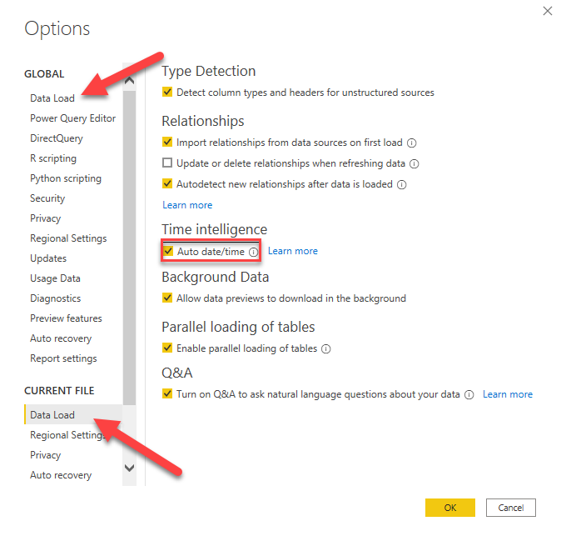
What is Auto Date/Time?
Loading option in Power BI
Support quick time intelligence reporting
Works only in Import mode
Column must be Date or Date/Time type
Column must be on the „1“ side of the relationship
How to enable it?

Slide 35
How it works?
Calculated table using CALENDAR() function
6 columns
Day
MonthNo
Month
QuarterNo
Quarter
Year
Relationship between Auto Date/Time Date and model date column
Contains full years!
2019-09-15
2022-03-09
2019-01-01
2022-12-31

Slide 36

Good...
Easy-to-use, quick, convenient way to apply Time Intelligence calculations
Works well with simple models
Handy feature for ad-hoc requests, data exploration and data profiling

Slide 37

Bad...
Flexibility = 0!!!
ALL or NOTHING
Year Start/End can‘t be modified
Can‘t be expanded to include other periods (weeks, week days, fiscal years...)
Single table filtering
Model size!!!

Slide 38
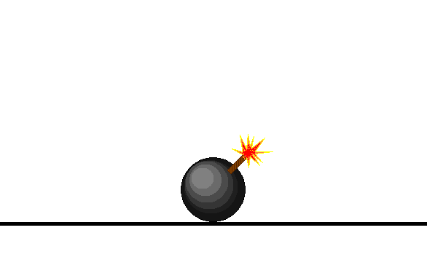
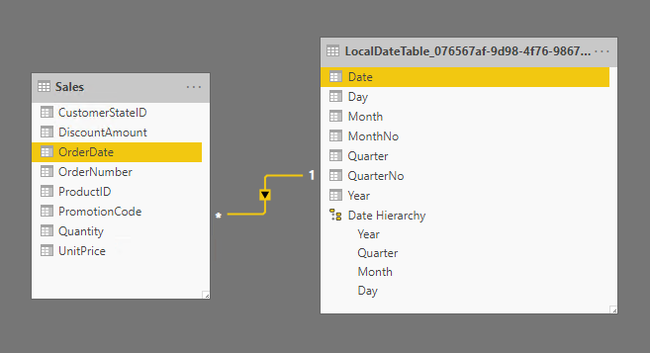
Ugly...
Hidden tables in your model!
For every single date field!
No DAX reference or Analyze in Excel
Search for MIN & MAX date value in your WHOLE column
2019-09-15
9999-12-31
2019-01-01
9999-12-31

Slide 39
DEMO
Auto Date/Time

Slide 40

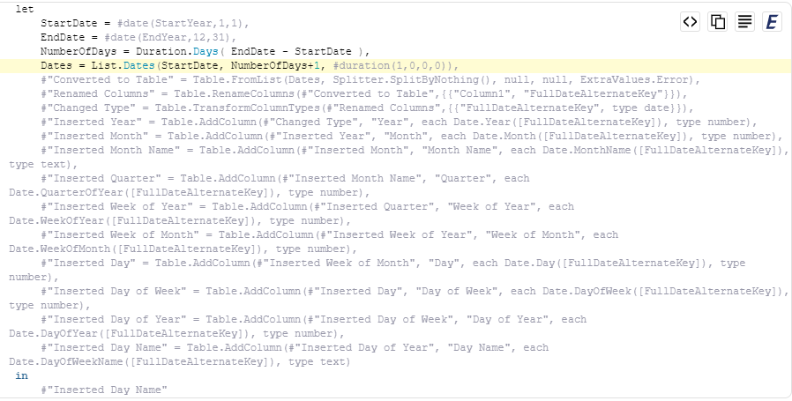
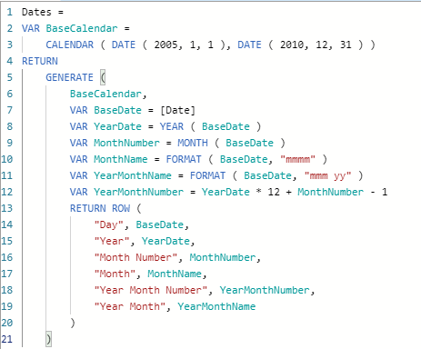
What should I do?
At least 3 possible solutions:
Date dimension from Data Warehouse
Power Query (M)
DAX Calendar table
https://radacad.com/create-a-date-dimension-in-power-bi-in-4-steps-step-1-calendar-columns
https://www.sqlbi.com/tools/dax-date-template/

Slide 41

Data Model Size - Best practices
Keep only necessary columns
Reduce the column cardinality
Keep only necessary rows
Aggregate when possible
Avoid calculated columns
Use proper data types
Disable Auto Date/Time

Slide 42

COFFEE & SNACK BREAK
See you soon…

Slide 43

DATA REFRESH PROCESS

Slide 44
Module Contents
Data Shaping & Power Query
Query folding
Devil is in the detail – Tips & Tricks
Demo

Slide 45



Data Shaping
Perfect world – Data just comes into our reports “as-it-is”
Not exclusively related to Power BI
BEFORE it becomes part of your data model!
WHERE should you perform Data Shaping?
New York
NYC
New York City

Slide 46

Power Query
More than 300 available transformations!
Transformation steps are saved
Mashup Engine + M language

Slide 47
What is Query Folding?
Translate M to a query language
Pushing heavy lifting on the data source
Ability to generate single SQL query that’s going to be executed on the data source side!

Slide 48







Query Folding and Data Sources
Relational database engines
OData, SSAS, SharePoint lists, Exchange, AD…
Some sources don’t support folding at all!

Slide 49

Query Folding and Data Transformations
Not all transformations will fold!
Subtle differences are sometimes decisive
Removing columns
Renaming columns
Filtering rows
Grouping/Summarizing
Merging queries from same source
Appending queries from same source
Simple Custom columns
Pivot/Unpivot
Merging queries from different sources
Appending queries from different sources
Complex Custom columns
Index columns
Changing column data type (“it depends”)!

Slide 50
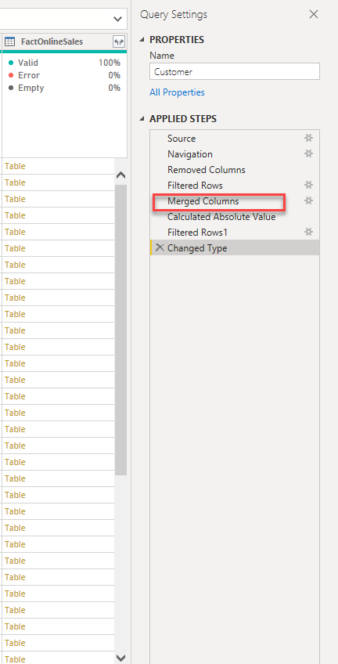
Query Folding – why should I care?
Data refresh more efficient
With DirectQuery/Dual the query must fold!
Incremental refresh
ALL or NOTHING?
Slow report
Slow visuals
Large data model
IT‘S NOT BECAUSE OF QUERY (NON)FOLDING!!!

Slide 51
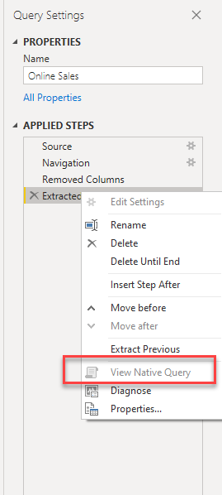
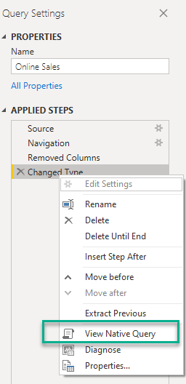

How do you know if the query folds?
View Native Query
It’s not 100% correct!!!
Use Query Diagnostics in PQ Editor or SQL Server Profiler
New feature in Power Query Online!
PROBABLY!!!

Slide 52

Devil is in the details!
Little nuances can make a big difference!
DEMO TIME!

Slide 53
Devil #1 – Change Data Type

Slide 54
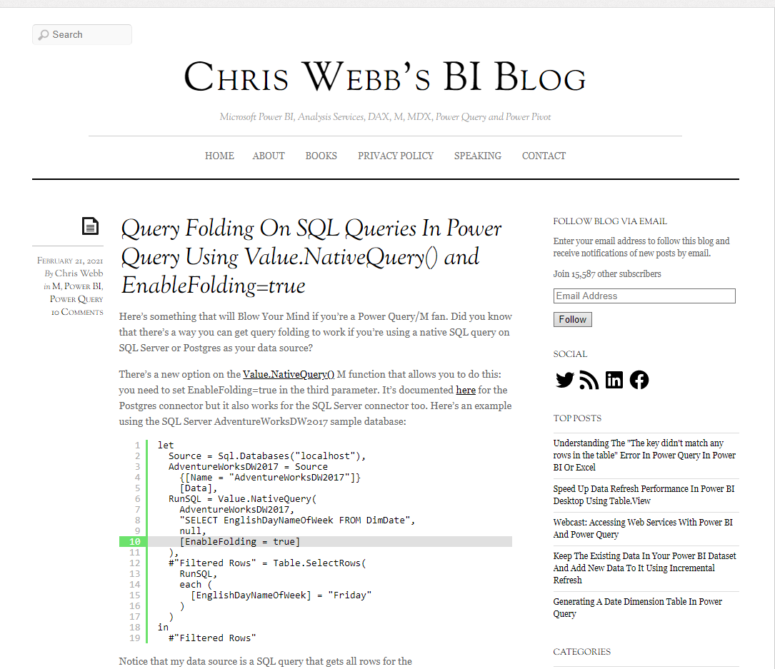
Devil #2 – Native SQL query

Slide 55
Devil #3 – When View Native Query lies…

Slide 56
Query folding – why should I care? Part 2

Slide 57
Visualizing Data Refresh process
- Demo -

Slide 58
Data Refresh process - Best practices
https://dax.tips/2021/02/15/visualise-your-power-bi-refresh/
Push transformations/calculations as close to a data source as possible
Create database views
ALL or NOTHING
Turn off Allow data preview to download in the background

Slide 59

DATA REFRESH PROCESS GOLDEN RULE
„Push transformations and calculations as upstream as possible,
and as downstream as necessary!“
Matthew Roche

Slide 60

LUNCH BREAK
Bon Apetit!

Slide 61

AGGREGATIONS

Slide 62

Aggregations
Why do I need aggregations?
What’s the benefit of having two identical tables in the data model?
User-defined vs Automatic Aggregations

Slide 63
Large Fact Table
Date | Customer ID | Product ID | Sales Amount
2021-10-12 | 123 | 11 | 10
2021-10-12 | 456 | 12 | 20
2021-10-12 | 789 | 12 | 50
2021-10-13 | 123 | 13 | 30
2021-10-13 | 456 | 11 | 10

Slide 64
Create Aggregated Tables
Date | Sales Amount
2021-10-12 | 80
2021-10-13 | 40
Date | Customer ID | Product ID | Sales Amount
2021-10-12 | 123 | 11 | 10
2021-10-12 | 456 | 12 | 20
2021-10-12 | 789 | 12 | 50
2021-10-13 | 123 | 13 | 30
2021-10-13 | 456 | 11 | 10
Product ID | Sales Amount
11 | 20
12 | 70
13 | 30
Customer ID | Sales Amount
123 | 40
456 | 30
789 | 50

Slide 65
Instruct Power BI to Use Aggregated Tables
Date | Sales Amount
2021-10-12 | 80
2021-10-13 | 40
Product ID | Sales Amount
11 | 20
12 | 70
13 | 30
Make Power BI “aware” of aggregated tables
Customer ID | Sales Amount
123 | 40
456 | 30
789 | 50

Slide 66
Create and manage aggregations
- Demo -

Slide 67

DAX CALCULATIONS

Slide 68

No deep-dive session on DAX!

Slide 69
Identifying a bottleneck
Capture DAX query
Performance Analyzer
DAX Studio
FE is single-threaded, SE is multi-threaded
SE solves basic math operations: SUM, MIN, MAX…

Slide 70
Understanding query plans
Logical plan is hard to understand
Engine translates logical plan in sequence of physical operations (joins, filtering…)
Physical plan doesn’t necessarily follow the order of logical plan steps!
Performance depends on the size of the columns in query

Slide 71
Understanding CallbackdataID
Whenever you include more complex logic
SE must call back FE to resolve the calculation
Has a huge impact on performance!

Slide 72
Step-by-step guide for optimizing DAX
Identify the most problematic query
Capture query plan in DAX Studio
Problem in FE or SE?
Solving a specific problem

Slide 73
Common issues in Storage Engine
Long scan time – depends on column size
High cardinality – impacts DISTINCTCOUNT and CALCULATE
Significant presence of CallbackdataID
Extensive materialization

Slide 74
Optimizing Filter Conditions
- Demo -

Slide 75
Optimizing IF statements
- Demo -

Slide 76
COFFEE & SNACK BREAK
See you soon…

Slide 77

VISUALS RENDERING TIME

Slide 78

Visuals Rendering Time
Performance Analyzer feature in PBI Desktop
The more visuals – the longer time for rendering!

Slide 79
Keep design – improve performance
- Demo -

Slide 80
Designing page background
- Demo -

Slide 81
Visuals Rendering - Best practices
Reduce the number of visuals!
Use PowerPoint to design background of Power BI report page
Reduce the number of DAX query generated – Card visuals->Matrix
Display aggregated data by default, enable Drill-through for details
Consider disabling cross-filtering
Sync Slicers?

Slide 82

STORAGE MODE DECISION

Slide 83
What is a DirectQuery ?
Data is retrieved from the source at the query time!
Data resides outside of Power BI before, during, and after the query execution
Direct Query will NEVER improve performance of your Power BI report!!!

Slide 84
When to use DirectQuery ?
Data is too large for Import mode
Real-time reporting requirements
Is it really necessary?
Security policies on the data source side

Slide 85
DirectQuery – Best Practices
Permissions on the data source?
Create proper indexes
Data integrity
Persistent data objects
Avoid complex PQ transformations
Avoid complex DAX measures
Avoid relationship on GUIDs
Limit parallelism and apply Query reduction
Check Assume referential integrity

Slide 86
Optimizing DirectQuery scenarios
- Demo -

Slide 87
Final wrap-up
Q&A
Grande Quiz

Slide 88

MONDAY TO-DO LIST
Identify the poor performing area(s)
Create a proper data model (Star schema)
Remove unnecessary data
Check Query folding
Take advantage of aggregations
Be mindful when writing DAX
Reduce the number of visuals on the page
Stay away from Direct Query!

Slide 89

GRANDE QUIZ

Slide 90

FEEDBACK
Help plant the trees
Win the prizes!
Important to organizers/speakers
https://sqlb.it/?6201

Slide 91

Data-mozart.com
@DataMozart
QUESTIONS

Slide 92

THANK YOU!
Data-mozart.com
@DataMozart

